Slide 1

The Adventures of LINQ

Slide 2

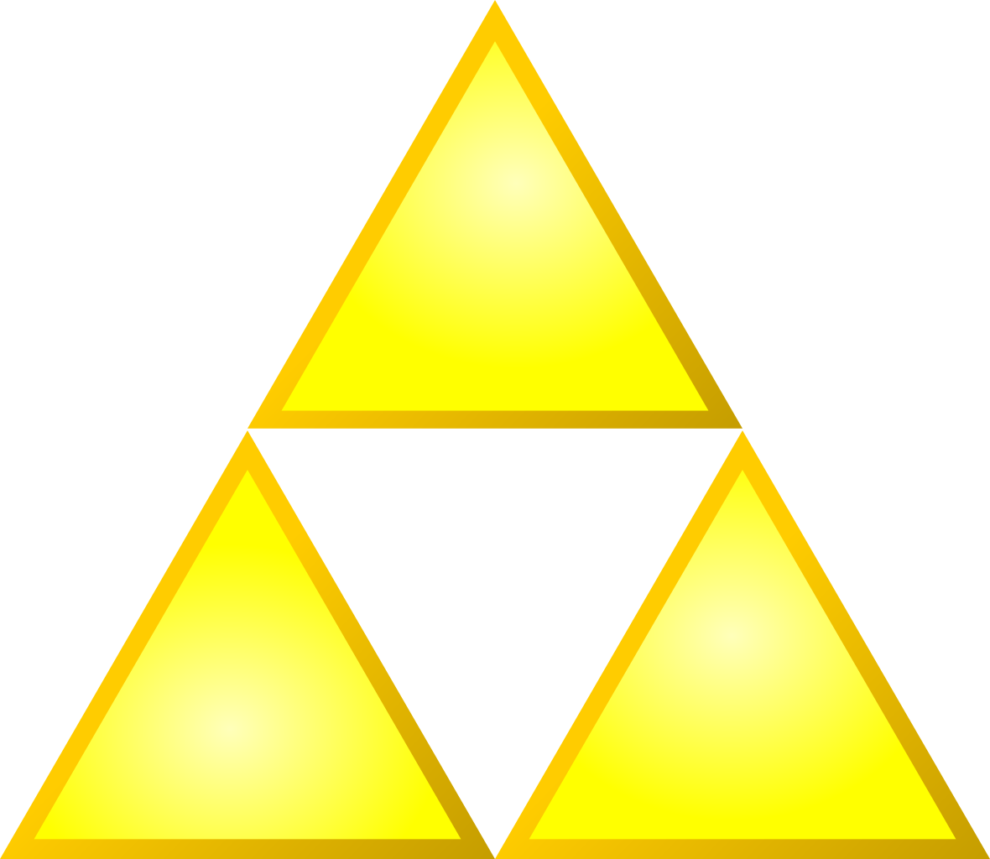
Darrell Jones
Software Engineer – Kaufman Hall and Associates

Slide 3
What is LINQ?
L - Language
I - I
N - Ntegrated
Q - Query

Slide 4
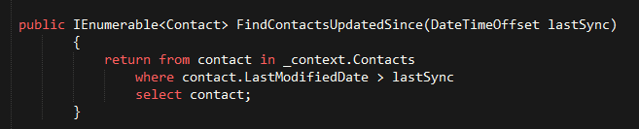

What is LINQ?
2 Types of Expressions
Query Expressions
Lambda Expressions

Slide 5
Lambda Expressions
Anonymous Functions
No need to specify name, return type, and access modifier
Saves time!

Slide 6
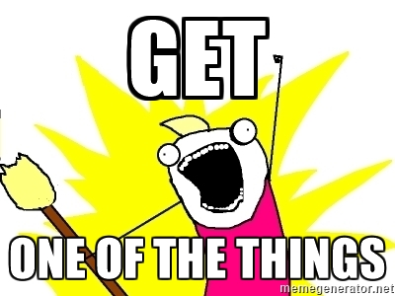
LINQ’d In
Return a Single Item
Select
Where (Sometimes)
FirstOrDefault

Slide 7
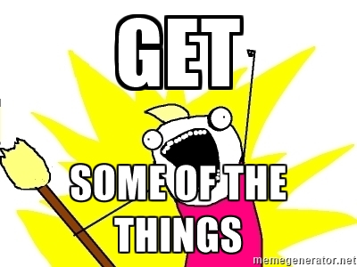
LINQ’d In
Return a Collection
Where (Sometimes)
Any
SelectMany
OrderBy
GroupBy

Slide 8

LINQ’d In
Method Chaining
OrderBy().ThenBy()
Where().Where().Where()

Slide 9

Questions?

Slide 10

Thanks!

